Slide 1

3.1 Boolean Algebra
3
In the late 1800’s, Irish philosopher George Boole incensed people by suggesting that logical thought could be represented with equations.
  How dare anyone suggest that human thought could be encapsulated and manipulated like an algebraic formula?
Computer circuits are effectively implementations of Boole’s Laws of Thought.
  In the 1930’s two American researchers independently discovered this idea: Claude Shannon and John Atanasoff.

Slide 2
3.2 Boolean Algebra
5
In this chapter we will study the essence of Boole’s work using modern notation.
Boolean algebra is a mathematical system for the manipulation of variables that can have only two values.
  In formal logic, these values are “true” and “false.”
  In digital systems, these values are “on” and “off,” 1 and 0, or “high” and “low.”

Slide 3
3.2 Boolean Algebra
5b
Boolean expressions are built by using Boolean operators to combine Boolean variables.
  Most people consider the fundamental Boolean operators to be AND, OR, and NOT.
NOT is a unary operator.
  So we can write NOT A.
AND and OR are binary operators.
  So we can write A AND B.
  Also, we can write A OR B.

Slide 4
3.2 Boolean Algebra
5c
AND plays the role of “multiply” in Boolean algebra, so it can be written using any symbol for “times”. It is called the Boolean product.
  AND is commonly written as concatenation, i.e., AB = A AND B.
  It can also be written as * or x, with a raised dot, or with an upside-down V (like an A without the bar).
OR plays the role of “add” in Boolean algebra, so it can be written using any symbol for “plus”. It is called the Boolean sum.
  OR is commonly written as +.
  It can also be written as V.

Slide 5
3.2 Boolean Algebra
5d
NOT plays the role of negation, so it can be written with any symbol for negation.
  NOT can be written with a minus sign (-).
  It can also be written with an overbar, or with the prime mark (’), the “elbow” (¬) or the exclamation point (!).
  Parentheses can be used to avoid confusion.
    (A)(-B) = A(!B) = A AND NOT B
    !AB = (!A)B = NOT A AND B

Slide 6
3.2 Boolean Algebra
5e
SInce we have multiple operators, we need to know the order of operations. It is similar to arithmetic:
  Parentheses have top priority.
  NOT has the next priority.
  AND is next.
  OR has the lowest priority.
AND binds tighter than OR.
  This is another way of saying that AND has priority over OR.
  This is parallel to * having priority over +.

Slide 7
3.2 Boolean Algebra
5f
Just as in arithmetic, it is better to use parentheses in complex expressions.
Example of notation
  A(B + C) = A AND (B OR C).
Example of order of operations
  A AND B OR C = (A AND B) OR C
  The above is true, but is hard for people to see without parentheses.
  AB + C is another way to write this expression. It is clear without the parentheses.

Slide 8
3.2 Boolean Algebra
5g
Examples of order of operations using NOT
  A OR NOT B = A + !B
  NOT A OR B = !A + B
  NOT (A OR B) = !(A + B)

Slide 9
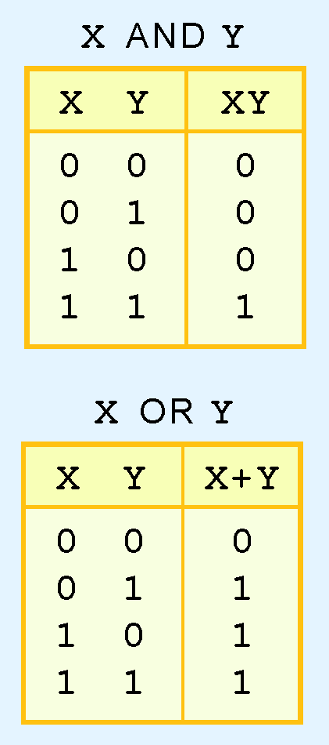
3.2 Truth Tables
6
A Boolean operator can be completely described using a truth table.
A truth table has one row for each possible value of the set of variables in the expression.
If the expression has 2 variables, the truth table will have 2² rows.
If the expression has 3 variables, the truth table will have 2³ rows.

Slide 10
3.2 Truth Tables
6c
The rows are printed in ascending order, e.g., 00, 01, 10, 11.
The variables are listed in the leftmost columns. The value of the expression is given in the rightmost column.
The truth tables for XY and X+Y are shown at the right.

Slide 11
3.2 Truth Tables
6d
The truth table for AND shows that X AND Y is only true when both X and Y are true.
Otherwise X AND Y is false.
So you can see in the table that there is only one 1 (true) in the result column. It is in the row where both X and Y are true.

Slide 12
3.2 Truth Tables
6e
The truth table for OR shows that X OR Y is true unless both X and Y are false.
So you can see in the table that there is only one 0 (false) in the result column, in the row where both X and Y are false.

Slide 13
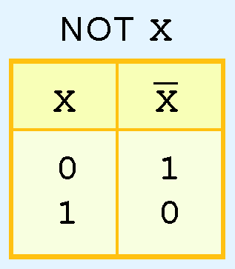
3.2 Truth Tables
7
The truth table for the Boolean NOT operator is shown at the right.
It has only 2¹ rows because there is only one variable in the expression.

Slide 14
3.2 Truth Tables
8
A Boolean function is a function of zero or more Boolean variables.
The output of a Boolean function is also a Boolean value, i.e., 0 or 1.

Slide 15
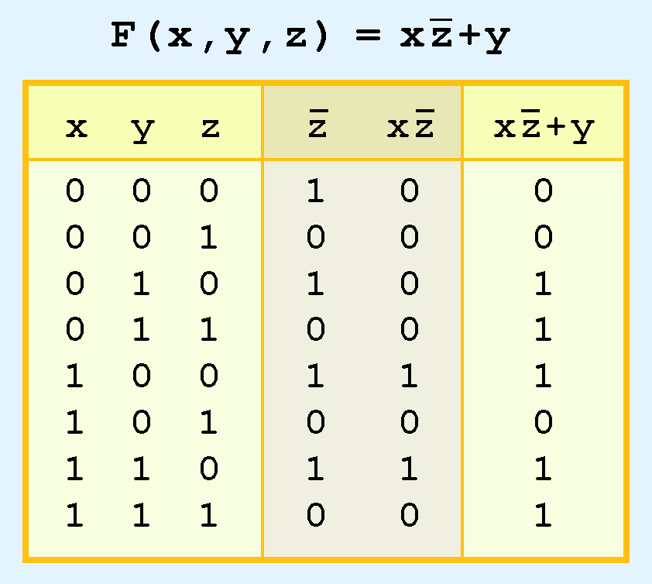
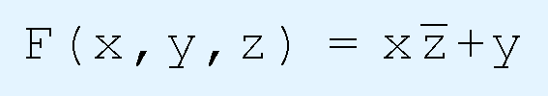
3.2 Truth Tables
9
The truth table for the Boolean function:
is shown at the right.
To make evaluation of the Boolean function easier, the truth table contains extra columns for subparts of the function.

Slide 16
3.2 Truth Tables
9b
For simplicity, we have drawn a line between the input variables and the work columns.
We have also drawn a line between the work columns and the result.
It is recommended to include a work column for every subexpression of a function.

Slide 17
3.2 Truth Tables
10
Remember that NOT has highest precedence, followed by AND and then OR.
So we need to evaluate X(!Z) first.
To do that, we need to evaluate !Z.
Then we can OR the result with Y.

Slide 18
3.2 Canonical Forms
18
In this section, we will learn to express expressions in standardized or canonical form.
There are numerous ways of stating the same Boolean expression.
  These synonymous forms are logically equivalent.
  Logically equivalent expressions have identical truth tables.
To make it easier to compare Boolean expressions, we use standardized forms called canonical forms.

Slide 19
3.2 Canonical Forms
19
The most useful canonical form for Boolean expressions is the sum-of-products form.
In the sum-of-products form, terms are connected by OR.
  Each term is made of variables (or their negations) combined with AND.
  Each term contains all the variables used in the original expression, either in their base form or their negated form.
  That is why it is called sum-of-products form.
  Example: f(x, y) = x(!y) + xy

Slide 20
3.2 Canonical Forms
19a
The terms used to make up sum-of-products form are called minterms.
  For a function of n variables, each minterm contains exactly n items AND’ed together..
  For example, the minterms with 2 variables are
  (-x)(-y), (-x)y, x(-y), xy
  Some or all of these terms are OR’d together to create the sum-of-products form for any function of two variables.

Slide 21
3.2 Canonical Forms
19b
To make the result unique, we need a way to ensure that the terms always come in the same order.
In this class we will use the following rule:
  1) Alphabetize the variables in each term.
  2) Alphabetize the terms, considering the negative form of a variable to precede the positive one, i.e., -x comes before x.
So whichever of the four minterms
(-x)(-y), (-x)y, x(-y), xy
are used, they will always be listed in that order.

Slide 22
3.2 Canonical Forms
19c
The purpose of a unique representation is to make it easy to compare two expressions.
  Just convert each expression to sum-of-products form, then compare them.
Here is an example of a sum-of-products form for a 3-variable expression:
F(x, y, z) = x(!y)(!z) + x(!y)z + xyz
  These minterms were chosen from the 8 possible minterms of 3 variables.
To show that every function can be expressed in sum-of-products form, we will give an algorithm on the next slide.

Slide 23
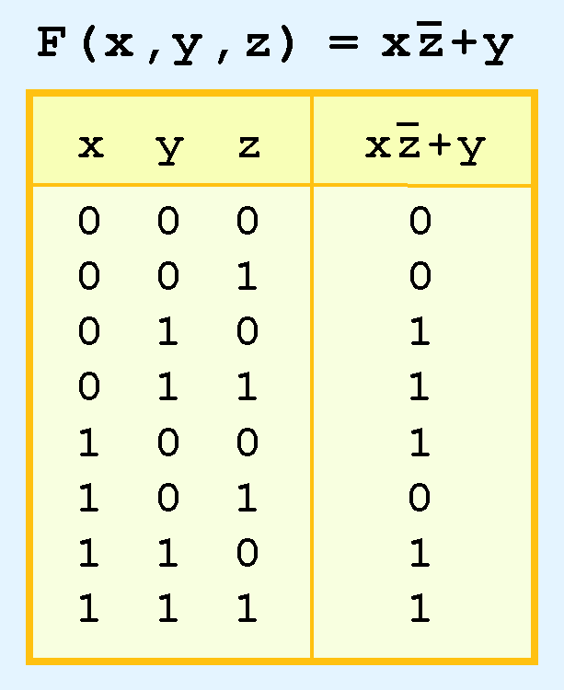
3.2 Canonical Forms
20
To convert a function to sum-of-products form, we start with its truth table.
Every row that results in a 1 contains a combination of values of variables that makes the function true.
So we AND together that set of values.
The function is true if any one of those sets of values occurs, so we OR the sets together.

Slide 24
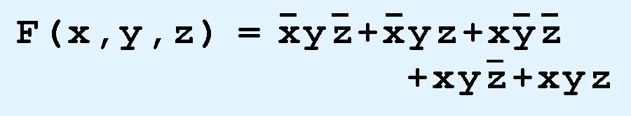
3.2 Canonical Forms
21
This function has 5 rows that return true, so our sum-of-products representation will have 5 terms.
Each term will show the values of x, y and z that are needed to make that term true. Remember that if x is false (0), then !x is true.

Slide 25
3.2 Canonical Forms
21b
If you build the sum-of-products form from a truth table as in this example, the terms will always come out in the correct order.
  You will not have to alphabetize them by hand.
You can check that you have correctly generated the sum-of-products form by building a truth table for the sum-of-products form.
  The result column should match the result column of the original function.
There is also a dual product-of-sums form which is occasionally useful, but we will not need it in this class.

